Slide 1

Pdas ca2
By: Adam bin roslan p2317425

Slide 2
Topic question
I want to find out whether the rise or decrease in total food establishment would have an increase in solid waste management, which in turn may result in a lower air quality in Singapore?

Slide 3
Why is this relevant to us and how does it affect us?
Environmental Impact: Understanding the relationship between the rise or decrease in food establishments and its impact on solid waste management and air quality is crucial for assessing the environmental footprint of the food industry. This knowledge can inform policies and practices aimed at mitigating environmental degradation.
Urban Planning: Singapore, like many urban centers, faces challenges related to managing waste and maintaining air quality amidst rapid urbanization and population growth. Exploring the interplay between food establishments, waste management, and air quality can provide insights for urban planners and policymakers to create sustainable and livable cities.
Public Health: Poor air quality can have detrimental effects on public health, contributing to respiratory problems and other illnesses. Understanding how changes in the food industry might influence air quality enables public health officials to anticipate and address potential health risks.
Economic Considerations: Effective waste management and air quality maintenance are essential for sustaining economic development. Assessing the impact of food establishments on these factors can help businesses and policymakers make informed decisions about investment, regulation, and resource allocation.

Slide 4



Urls of my datasets from data.gov
https://beta.data.gov.sg/collections/1447/view https://tablebuilder.singstat.gov.sg/table/TS/M891321 https://tablebuilder.singstat.gov.sg/table/TS/M890641

Slide 5
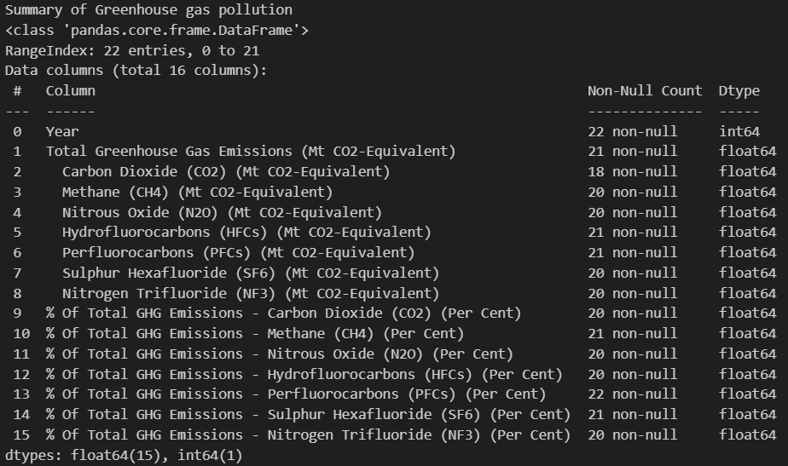
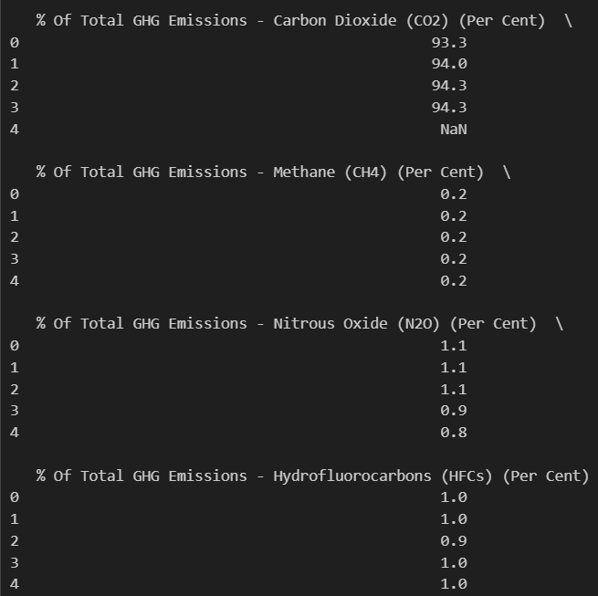
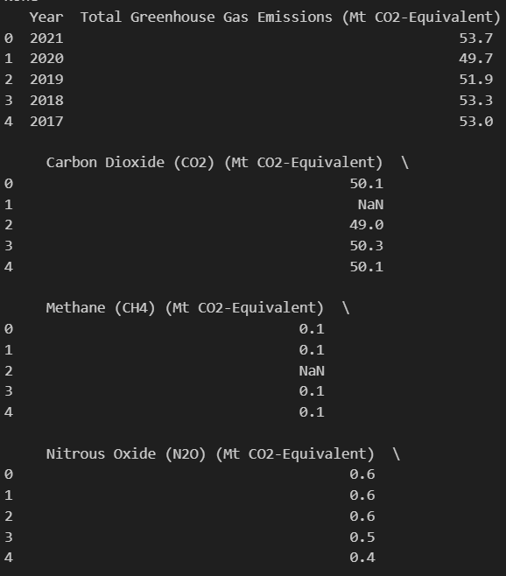
#1 dataset: greenhouse gas pollution.csv

Slide 6
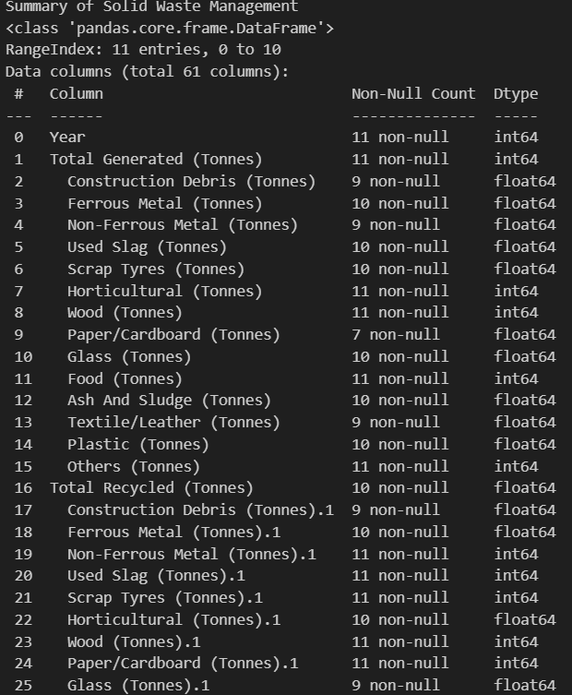
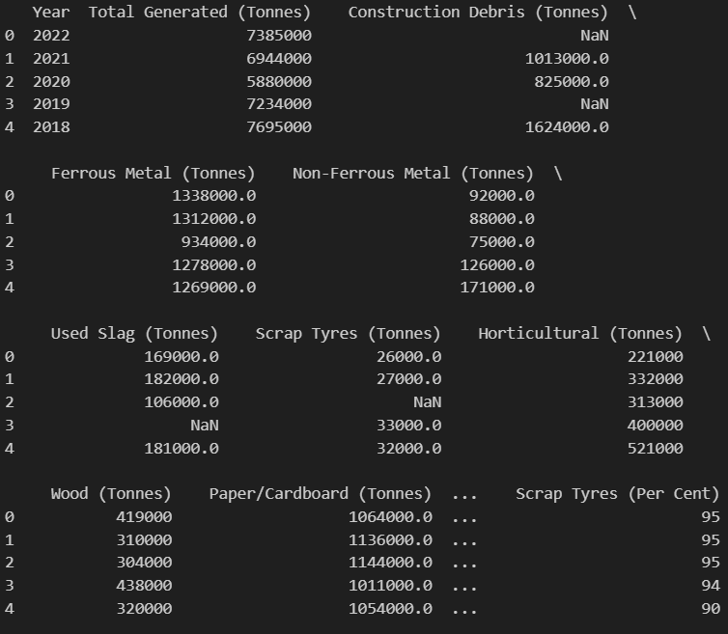
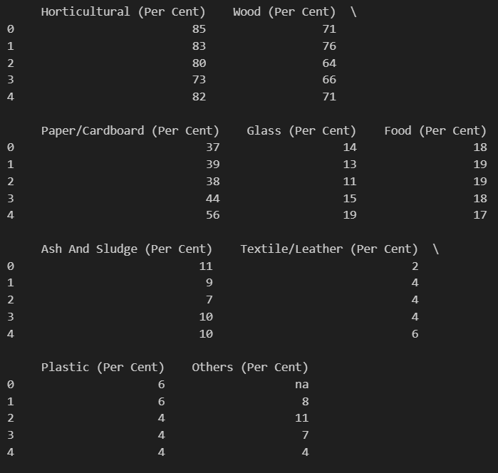
#2 dataset: solid waste management.csv

Slide 7
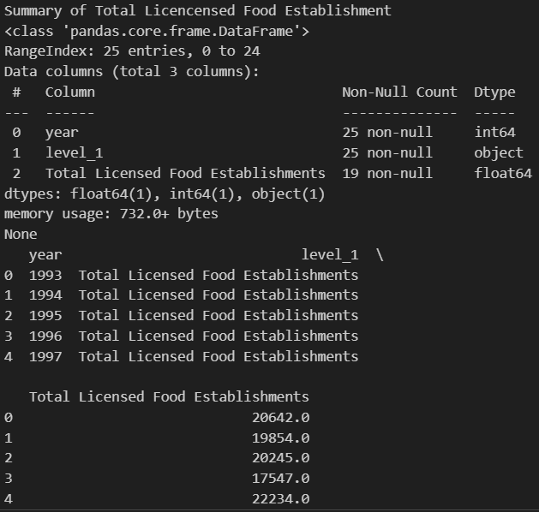
#3 dataset:total licensed food establishments.csv

Slide 8



DATA PROCESSING AND Data cleaning

Slide 9
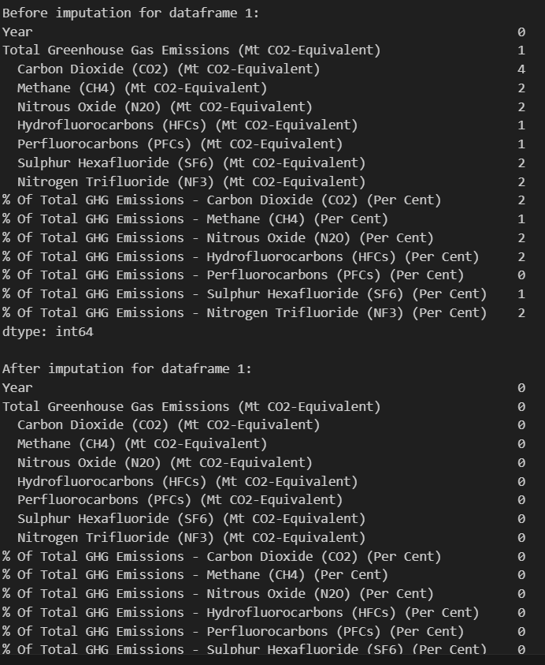
#1 DATA PROCESSING AND ANALYSING of : greenhouse gas pollution.csv
We can see from the image there are missing values in the Carbon Dioxide, Methane and etc, in the dataset
Therefore, I created a function that handles missing data values with the mean (average) of the column
It can be seen that after imputation, there are 0 missing values which shows that the dataset has been successfully imputated.

Slide 10
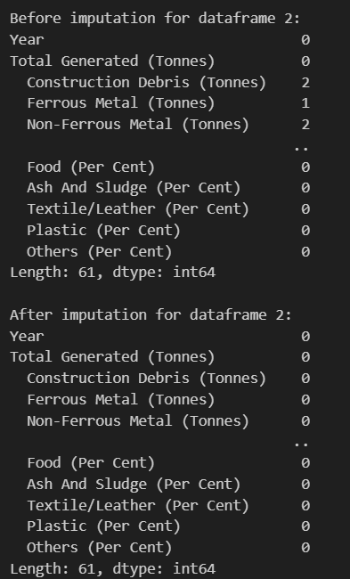
#2 DATA PROCESSING AND ANALYSING of solid waste management.csv
We can see from the image there are missing values in the Construction Debris (Tonnes), Ferrous Metal (Tonnes) and Non_Ferrous Metal etc , there are more columns but its not shown as its too long in the dataset
Therefore, the function is put in place to handle missing data values with the mean (average) of the column.
It can be seen that after imputation, there are 0 missing values which shows that the dataset has also been successfully imputated.

Slide 11
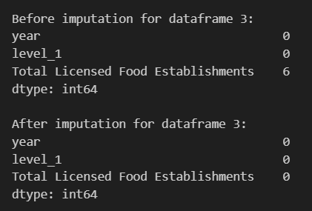
#3 DATA PROCESSING AND ANALYSING of A total licensed food establishments.csv
We can see from the image there are missing values in the total number of licensed food establishment in the year 2017 Jan and 2017 April and etc, there are more columns but its not shown as its too long in the dataset
Therefore, the function is put in place to handle missing data values with the mean (average) of the column.
It can be seen that after imputation, there are 0 missing values which shows that the dataset has also been successfully imputated.

Slide 12
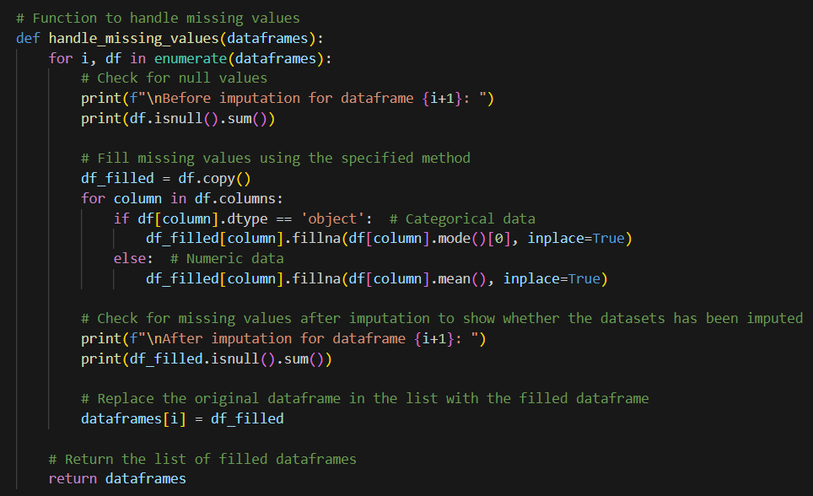
Function to handle missing data

Slide 13
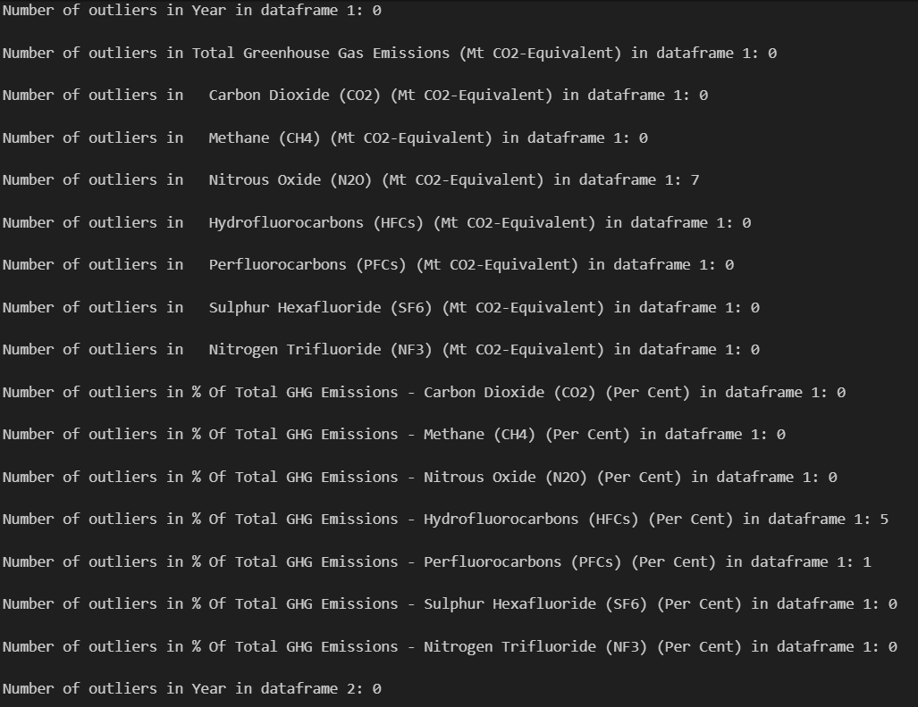
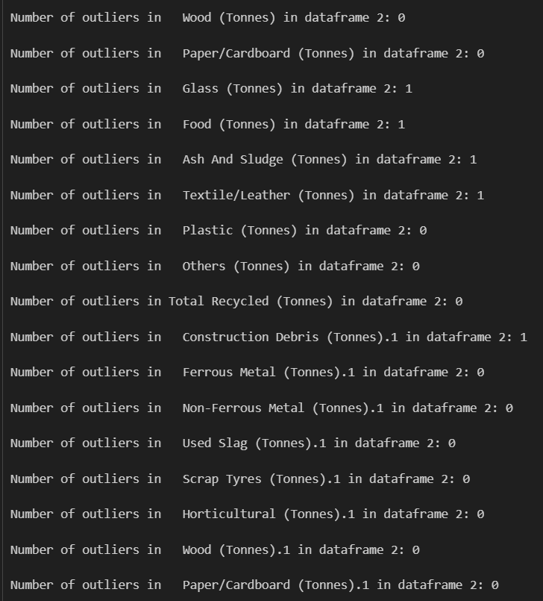


Calculating outliers and removing

Slide 14
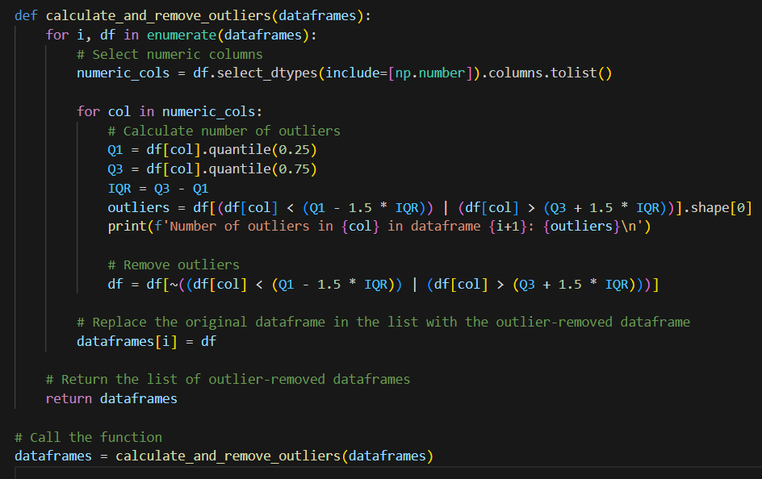
Function that I used to calculate outliers and remove them

Slide 15
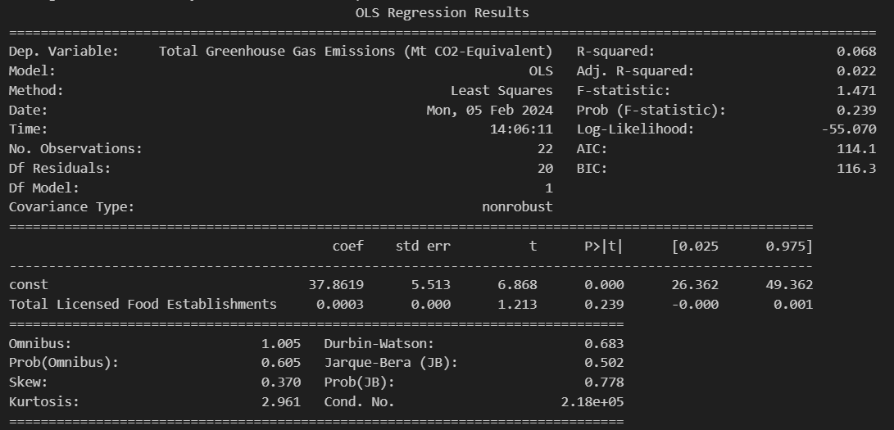
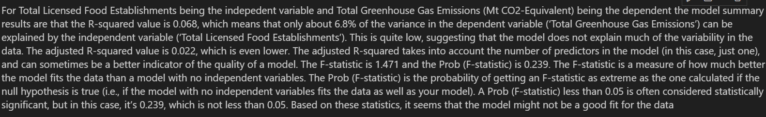
Model summary For total Total Licensed Food Establishments being the indepeNdent variable and Total Greenhouse Gas Emissions being the dependent

Slide 16
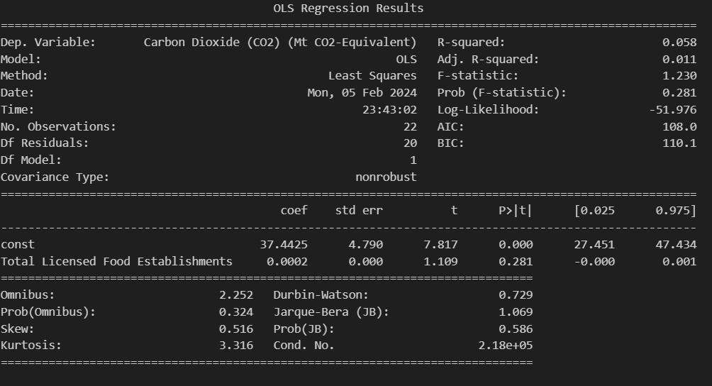
Model summary For total Total Licensed Food Establishments being the indepeNdent variable and Co2 being dependent

Slide 17
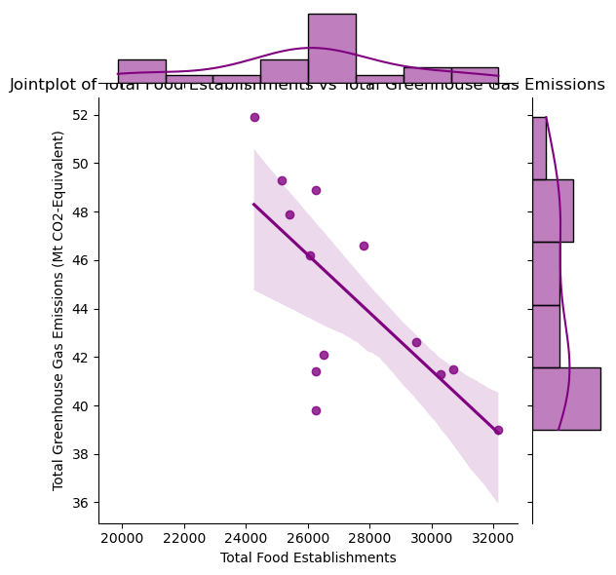
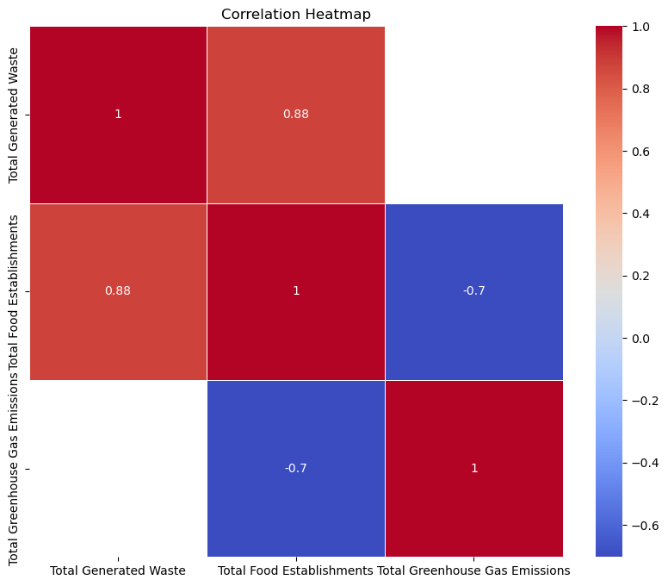
Data insights
There is a strong positive correlation of 0.88 between “Total Generated Waste” and “Total Food Establishments”.
There is a moderate negative correlation of -0.7 between “Total Food Establishments” and “Total Greenhouse Gas Emissions”.
There is also a moderate negative correlation of -0.7 between “Total Generated Waste” and “Total Greenhouse Gas Emissions”.
A shaded area indicates the confidence interval around a linear regression line fitted through the data points, suggesting a negative correlation between the two variables. This means as the number of food establishments increases, the greenhouse gas emissions decreases.

Slide 18
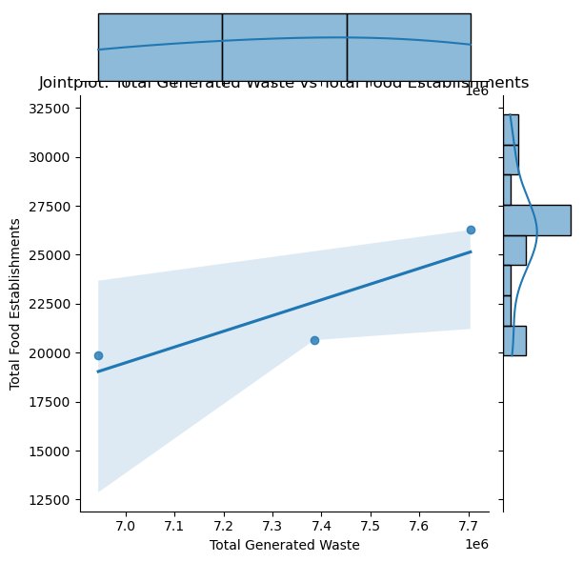
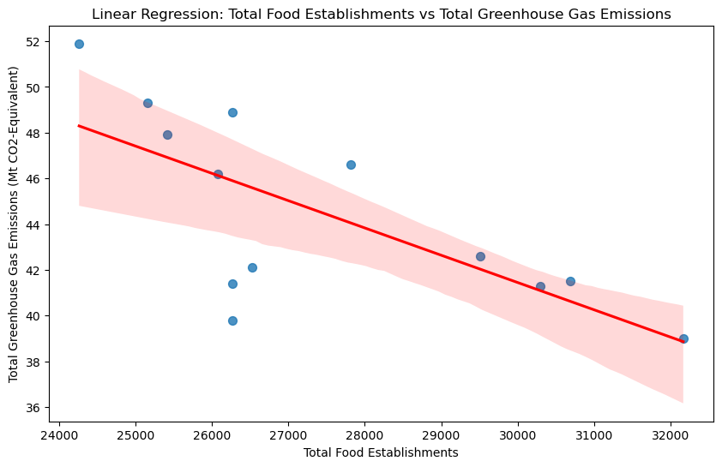
Data insights
Each blue dot on the plot represents a specific data point where both variables were measured.
A blue line connects all data points indicating an upward trend; as total food establishments increases, total waste increase.
There’s a shaded blue area around the line representing confidence intervals or areas of uncertainty.
On top of the graph, there’s a smaller histogram showing distribution for Total Generated Waste.
On the right side of the graph, another smaller histogram shows distribution for Total Food Establishments.
From this image , we can conclude that as the total food establishments increases, the total greenhouse Gas decreases and the data points are also quite scattered which shows that there is not much correlation between total food establishments and total greenhouse gas emissions.

Slide 19
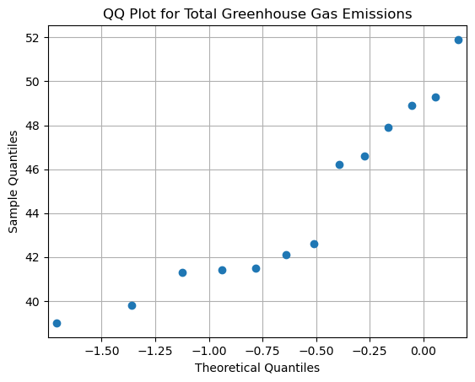
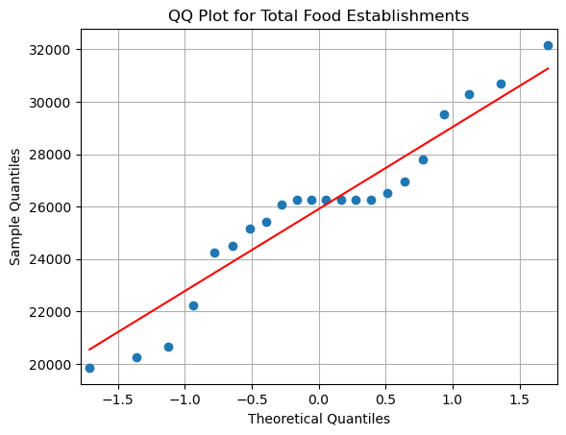
Data insights

Slide 20
Conclusion
From the graphs and the model summary , we can see that between the three datasets, there are little correlation between them which shows that there are much more factors in play. Therefore , the topic question that im trying to find is not true .

